Slide 1
From Prototypes to Protocols: Building the Ecosystem for In-Network Computing
Wenfei Wu
Peking University

Slide 2
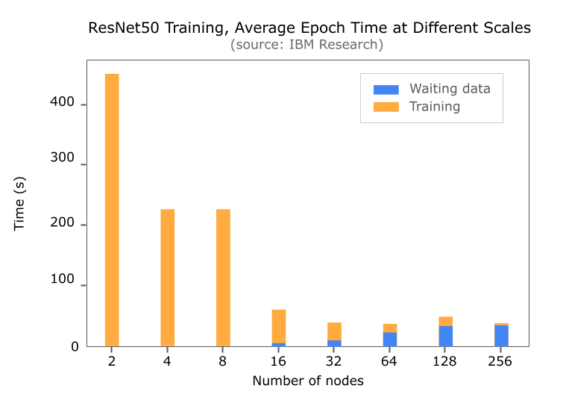
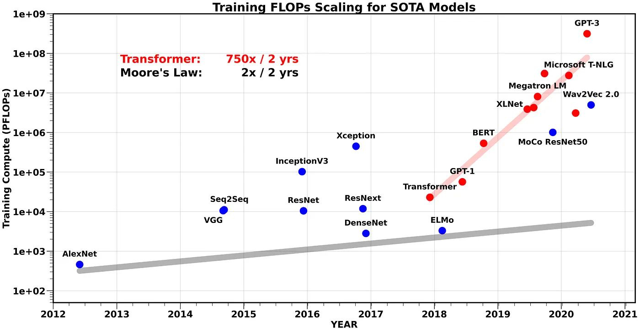
The Communication Bottleneck in Distributed Systems
Large-model training/inference and big-data analytics run at cluster scale.
Data exchange cost is non-negligible in the overall job time.
HPC clusters are single-domain, which can apply programmable dataplanes to enable end-to-end customization.
750X/2y increase of FLOPS requirement ≫ Network Increase
Idle GPU time in large-scale training

Slide 3
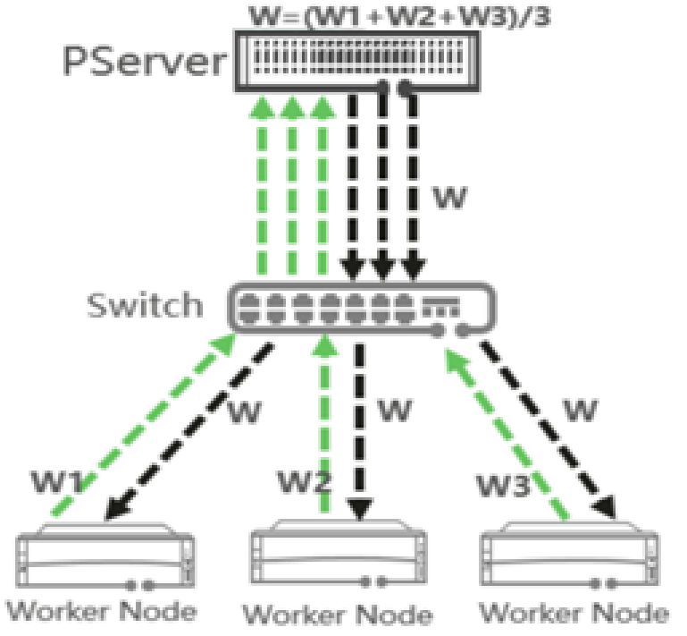
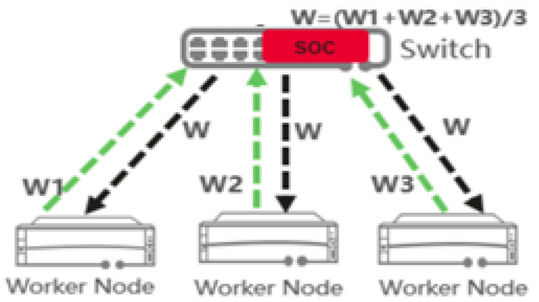
In-Network Computing (INC)
Offload application functions to network devices (switches in this talk)
Accelerate applications by
  reducing traffic volume
  reducing transmission hops
  packet-granular computation-communication pipelining
  freeing host CPU/GPU for other computation
compute
offload
Global
Sub-RTT
bottleneck
compute
Local

Slide 4
INC: offload application functions to switches
(new research space)
Fundamental Questions
What is the function (computation) to offload?
What is the switch hardware architecture to
support the computation?
How to develop the functions to the architecture?
We are still exploring the answer. Today,
Give use cases of INC
Give intuitions (as future works) for these questions
Same Questions for Programmable Dataplanes
Network functions
PISA pipeline
P4

Slide 5

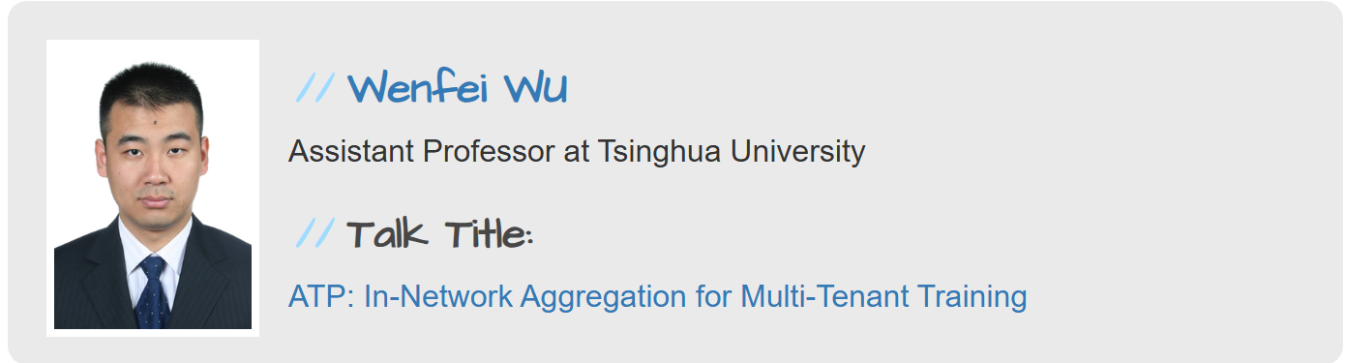
The path we have taken（in 2021）
Progress
A case: offload AllReduce in
multi-tenant clusters
Future work (at that time)
More applications
Resource management for more scenarios
Protocol verification

Slide 6

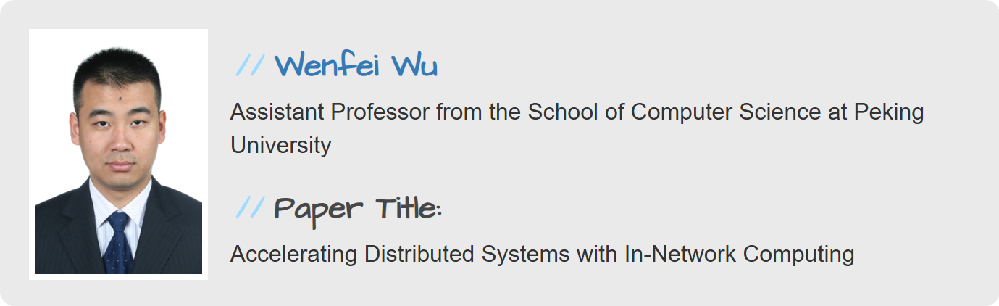
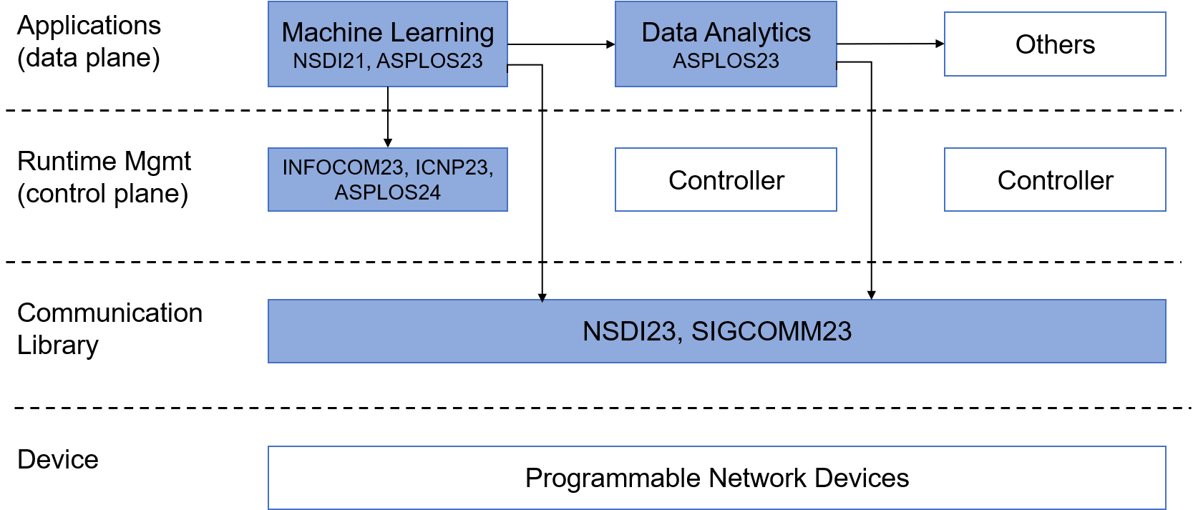
The path we have taken （in 2023）
Progress
Offload AllReduce
Offload ReduceByKey
Resource management
  Job placement in INC clusters
  Runtime INC resource scheduling
Future work (at that time)
“the blank boxes”
  More applications
  Devices

Slide 7
Today
Part 1: Effort needed by device vendors
Part 2: A new INC case for long-context inference
We first introduce the concept of INC-empower AllReduce

Slide 8
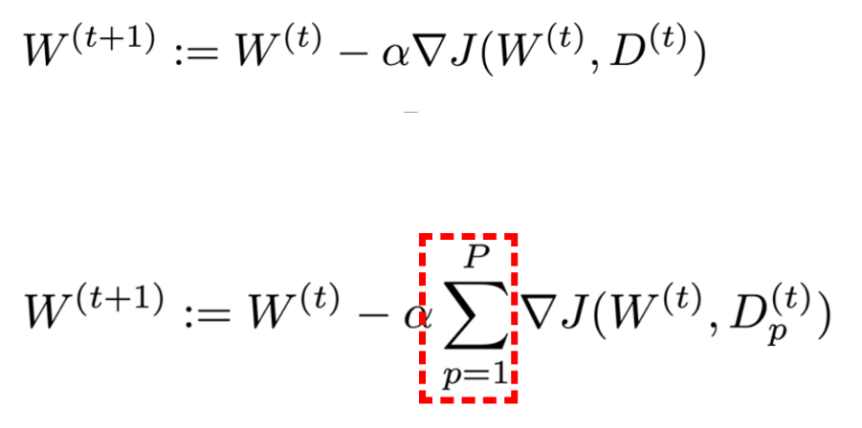
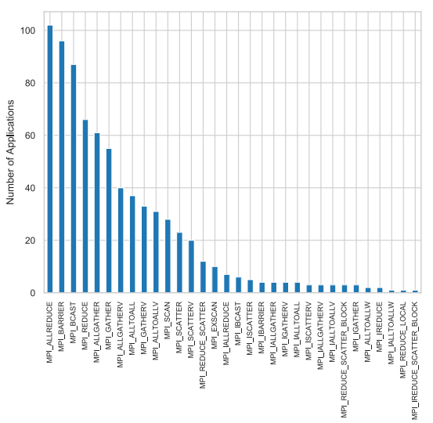
Model Training Algorithm
Algorithm: Iterate until converge
  Compute a gradient
  Update the model
In data parallel training
  Each worker computes a gradient
  Aggregate all workers’ gradients, send the result back
  Each worker updates the model
AllReduce
  Sum up vectors across hosts and
  return the result to all hosts
  Also exist in tensor parallel
widely used in AI/HPC
parallel programming
Laguna, et al. A Large-Scale Study of MPI Usage in Open-Source HPC Applications, SC’19

Slide 9
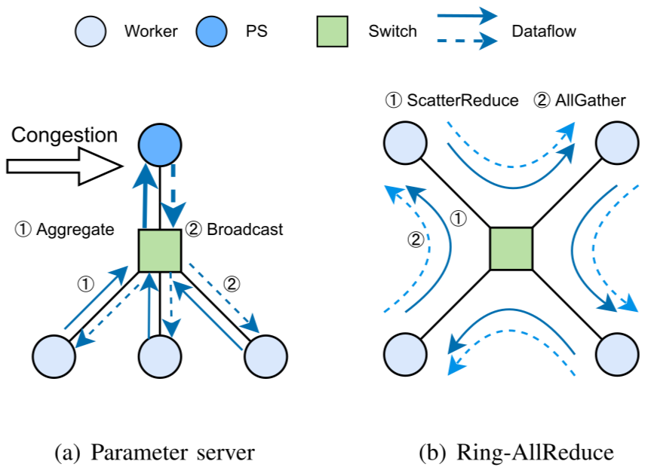
Host-centric Solutions
Parameter Server (PS)
  Send all vectors to PS
  PS sums up and returns
  PS suffers from more traffic volume
Ring AllReduce
  Hosts form a ring
  Host relays intermediate vector along the ring
  Round 1: each host accumulates its own vector
  Round 2: each host store the result
  The two-round vector passing doubles the traffic volume

Slide 10
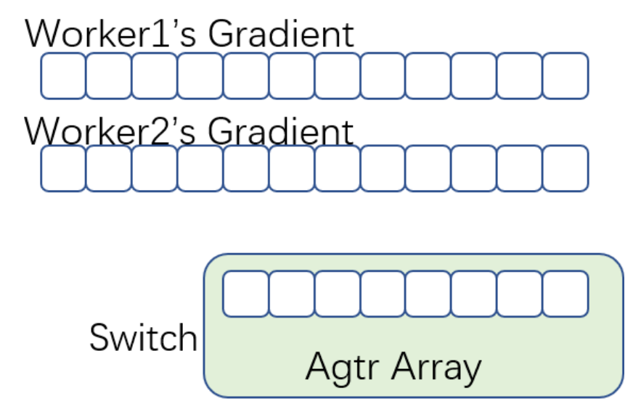
INC Design Data Structure
Worker: chunk the gradient as a packet sequence
  Maintain a sliding window sized W to stream packets
Switch: organize the SRAM as an array of aggregators, sized N
Sapio, et al. Scaling distributed machine learning with In-Network aggregation, NSDI 2021 (KAUST, Microsoft, U Washington)
Liu, et al. In-network aggregation with transport transparency for distributed training, ASPLOS 2023 (Huawei , PKU, CityU)

Slide 11
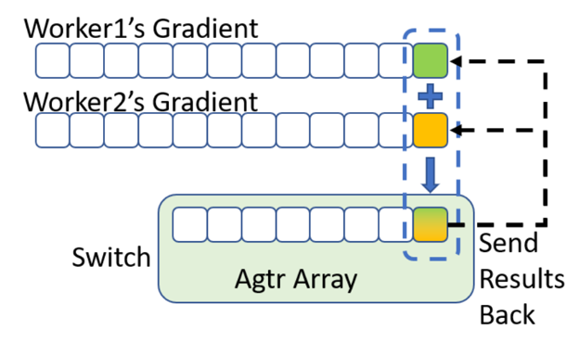
Workflow
Workers always sends packet in window
Switch addresses each packet to an aggregator
When switch completes an aggregation, it multicasts ACK to workers
  ACK piggybacks results
ACK advances worker’s window,
and worker sends new packets
$$Aggregator.idx=PSN \% N$$
W≤N to avoid addressing errors.
(necessary not sufficient)

Slide 12
Workflow (ideal case)
Switch
Agtr Array
1
0
Size is 2
1
0
1
0
Gradient
5
4
3
2
1
0
Gradient
5
4
3
2
1
0
Window Size is 2
worker
worker

Slide 13
Workflow (ideal case)
Switch
Agtr Array
1
0
Size is 2
1
Gradient
5
4
3
2
1
0
Gradient
5
4
3
2
1
0
Window Size is 2
worker
worker

Slide 14
Workflow (ideal case)
Switch
Agtr Array
1
0
Size is 2
1
0
0
Gradient
5
4
3
2
1
0
Gradient
5
4
3
2
1
0
Window Size is 2
worker
worker

Slide 15
Workflow (ideal case)
Switch
Agtr Array
1
0
Size is 2
2
2
Addressing: PSN%N
Gradient
5
4
3
2
1
0
Gradient
5
4
3
2
1
0
Window Size is 2
worker
worker

Slide 16
Other Considerations
How to handle packet loss?
  Host applies ARQ to retransmit unACKed data packet
  Switch runs deduplication to avoid duplicate computation
How to recycle (small) switch memory for (large) messages?
  Codesign with windowing protocol: when observing inflight PSN, clear one window away
Congestion Control: work within the window constraint
Floating-Point Support: (De)quantization

Slide 17
Evaluation Environment
Cluster
  Server*4: GeForce 3090 GPU, Mellanox CX5 100GbE NIC
  Switch*1: Tofino 1, link bandwidth 100Gbps*32
Workload: NCCLTest AllReduce
Metric: Algorithm Bandwidth
  data size / completion time

Slide 18
Evaluation Results
With the same MTU, INC improves throughput by up to 40%
Message Size | INC | NCCL
64KB | 8.7 | 11.8
256KB | 35.2 | 16.8
1MB | 74.2 | 57.5
4MB | 80.2 | 66.0
16MB | 83.0 | 59.7
64MB | 86.2 | 61.4
256MB | 88.4 | 62.3
1GB | 87.8 | 62.6

Slide 19
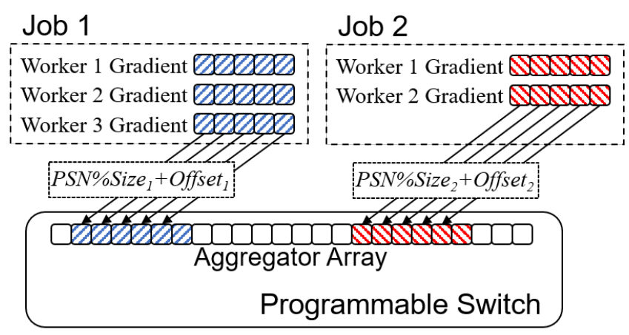
Other Considerations
Resource Management: How to allocate switch memory to jobs?
  (Job Initialization) Where to place jobs in the cluster considering INC resources?
  (Job Runtime) How to multiplex INC resources among jobs?
Lao, et al. ATP: In-network aggregation for multi-tenant learning, NSDI 2021 (Tsinghua, UW-Madison, Intel)
Zhao, et al. Enabling switch memory management for distributed training with in-network aggregation. INFOCOM 2023 (Tsinghua, PKU)
Wang, et al. Preemptive switch memory usage to accelerate training jobs with shared in-network aggregation. ICNP 2023 (PKU, HKUST)
Zhao, et al. Training job placement in clusters with statistical in-network aggregation. ASPLOS 2024 (PKU, Tsinghua)

Slide 20

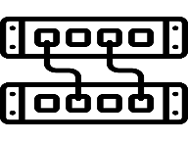
Since 2023, we try to persuade vendors to apply INC
We expect to reshape the ecosystem
From a layer architecture to a holistic one
Application
Application
Application
Application
Content Provider
Comm Lib
Comm Lib
Comm Lib
Transport
Network
Link
Comm Lib
Transport
Network
Link
Comm Lib
Transport
Network
Link
Transport
Transport
OS Vendor
New
Infra
Vendor
Network
Network
Network
ISP
Link
Link
Link
Device Vendor
host
net device
host
Host
Net Device
Host
The Internet Architecture
The AI Network Architecture

Slide 21
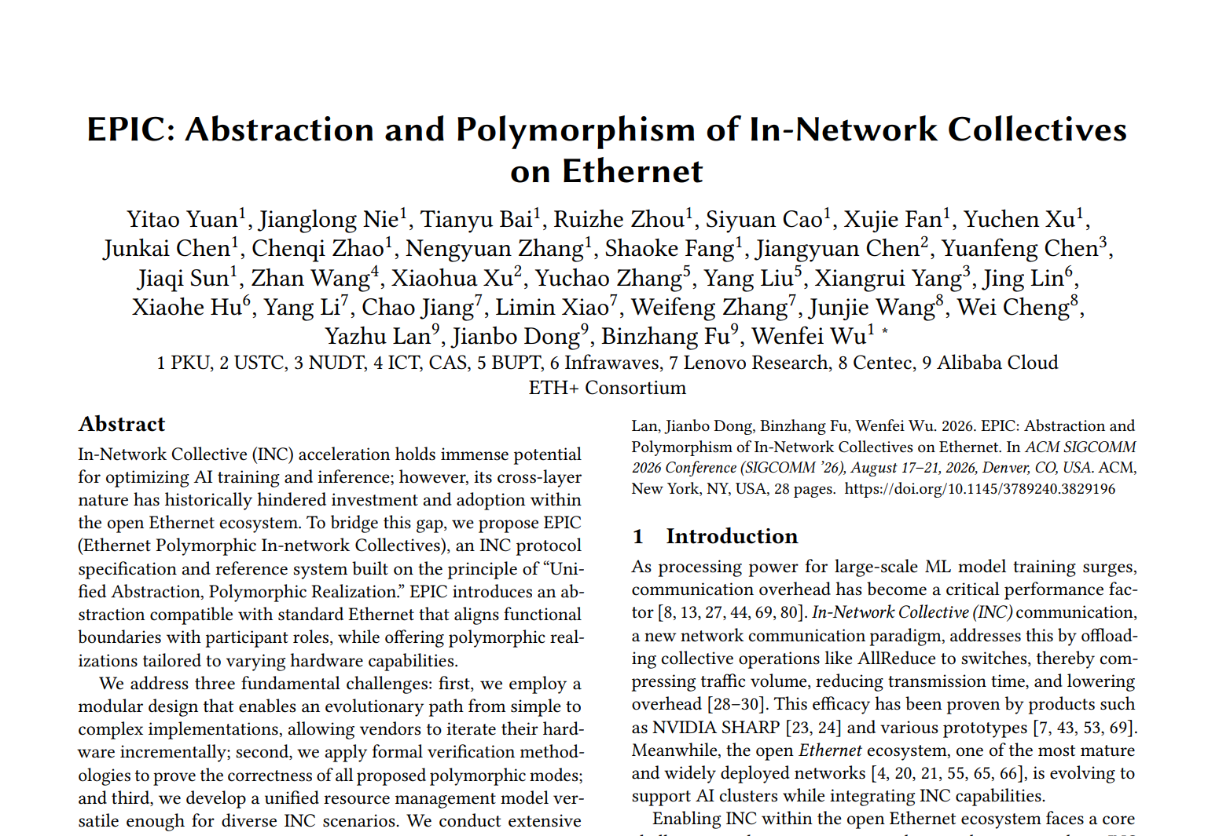
Contents
Background
Enforce In-network Collective Communication on Ethernet
A New INC Case for Context Parallelism
Conclusion
Eth+ Consortium, In-network Collective Specification, 2024
Yuan et al., EPIC: Abstraction and Polymorphism of In-Network Collectives on Ethernet, SIGCOMM 2026 (PKU, etc.)

Slide 22
Initial Vision Revisited
Intuition: cross-layer construction for performance gain
Application
Application
Content Provider
Comm Lib
Transport
Network
Link
Comm Lib
Transport
Network
Link
Comm Lib
Transport
Network
Link
New Infrastructure Vendor
This seldom happens
Host
Net Device
Host
Too few such vendors to handle all layers.

Slide 23
Problem 1: Cross-layer system vs Open ecosystem
INC is cross-layer, including
  CCL, protocol stack, NIC, switch, network controller
Ethernet is an open ecosystem. INC spans econiches:
  CCL developer, protocol stack developer, NIC vendor, switch vendor, network controller developer
Concerns for a single party:
  Single party cannot complete the whole system and obtain the gain.
  Adding new functions in each functional scope is expensive.
Poor return-on-investment (ROI) deters vendors from committing resources.

Slide 24
Problem 2: Switch vendors differ
Type-I: Some vendors build both switches and NICs (RoCE)
Type-II: Some vendors only build switches
An INC design requiring RoCE stack would prevent type-II vendors.
Many NIC vendors are building RoCE NICs.
Type-II vendors cannot follow type-I vendors’ technical approach

Slide 25
Solution: Unified Abstraction, Polymorphic Realization
Unified Abstraction: break upstream-downstream vendor lock-in
  More choices for one vendor
Polymorphic Realization: multiple vendors for each econiche
  Reduce investment
root
switch 3
switch 4
edge
endpoint
ep6
IP6, QP6, eth2
IP12, QP12, eth3
ep12
ep5
ep11
switch 1
switch 2
IP5, QP5, eth1
IP11, QP11, eth1
ep2
ep4
ep8
ep10
IP2, QP2, eth2
IP4, QP4, eth3
IP8, QP8, eth2
IP10, QP10, eth3
ep1
ep3
ep7
ep9
leaf
leaf
leaf
leaf
host 1
host 2
host 3
host 4
IP1, QP1, eth0
IP3, QP3, eth0
IP7, QP7, eth0
IP9, QP9, eth0
(a) An aggregation tree (b) Aggregation tree on Ethernet cluster

Slide 26
Abstraction: Components and Econiche
Preserve standard interfaces between functional scopes
  Switch, NIC, CCL, Network Controller
Host
Host
data IO via collectives
Control Plane
GPU
GPU
GPU
GPU
APPLICATION
Content Provider
IncManager
message IO
via verbs
CommLib
CommLib
COL. COM. Lib.
OS Vendor
NIC
RoCE
RoCE
NIC
TRANSPORT
NIC Vendor
packet IO
Switch
IncAgent
Cluster Operator
IncEngine
NETWORK LAYER
Switch Vendor
Network

Slide 27
Polymorphism: Mode-I (Connection Terminated)
For vendors with both switch and RoCE capability, e.g., Nvidia
Switch IncEngine reuses RoCE, add extra application-layer computation
  RoCE assemble packets as messages
  IncEngine reduces and replicates on messages
  RoCE sends messages as packets
IncEngine is like a Parameter Server
LookupTable
packets
RoCE
IncEngine
msg
(De)packetization
LookupTable
UP_DATA
ConnectionMgmt
AggregateData
Retransmission
DOWN_DATA
msg
HandleAck
ReplicateData
packets
Forward
switch workflow

Slide 28
Mode-II: Connection Translated
LookupTable
UP_DATA
DOWN_DATA
CheckDuplicate
For vendors with ordinary Ethernet switch capability,
but no RoCE technical reserves
Minimalist design to achieve INC, with RoCE
interoperability
AggregateData
RecycleBuffer
ReplicateData
TranslateHeader
ACK
Forward
Legends upward data packet downward data packet ACK packet
switch workflow
acknowleging
acknowleging
(a) Upward data packet (b) Downward data packet (c) Reply ACK packet (d) Reflect ACK packet

Slide 29
Mode-III: Connection Enhanced
LookupTable
DATA
ACK
CheckDuplicate
ReceiveAck
For vendors evolving to switch+RDMA
Add per-hop ACK and retransmission
The middle ground between Mode-I and Mode-II
AggregateData
RecycleBuffer
ReplicateData
SendAck
TranslateHeader
Retransmission
timer
Forward
Legends upward data packet downward data packet ACK packet
switch workflow
(a) Level-1 Aggregation (b) Level-2 Aggregation (c) Level-2 Broadcast (d) Level-1 Broadcast

Slide 30
Evolvement among Modes
A vendor can evolve modes from simple to complex.
LookupTable
LookupTable
LookupTable
UP_DATA
DOWN_DATA
DATA
ACK
packets
CheckDuplicate
CheckDuplicate
ReceiveAck
RoCE
IncEngine
msg
AggregateData
(De)packetization
LookupTable
AggregateData
RecycleBuffer
UP_DATA
RecycleBuffer
ConnectionMgmt
AggregateData
ReplicateData
SendAck
Retransmission
DOWN_DATA
ReplicateData
msg
HandleAck
ReplicateData
TranslateHeader
ACK
TranslateHeader
Retransmission
timer
packets
Forward
Forward
Forward

Slide 31
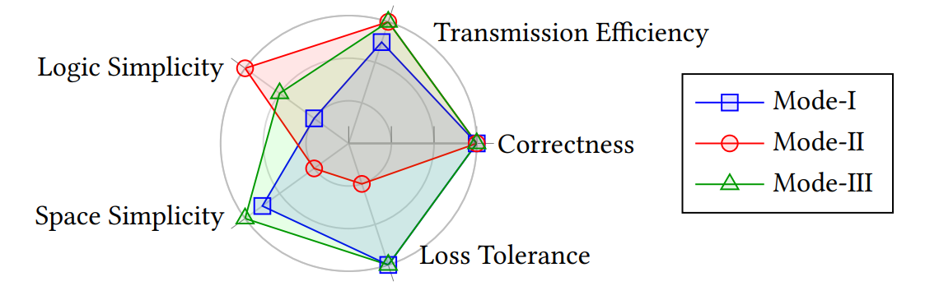
Comparison of Modes
Correctness: by model checking
Transmission Efficiency: Mode-I is message-level
Logic Complexity
Space Complexity: Mode-II needs path BDP, Mode-I/III needs hop BDP
Loss Tolerance: Mode-II’s global synchronization performs poorly
 | Mode-I | Mode-II | Mode-III
Correctness | Yes | Yes | Yes
Trans. Efficiency | Lower | Good | Good
Logic Complexity | High | Low | Medium
Space Complexity | Low | High | Low
Fault Tolerance | Good | Poor | Good
Radar Chart (Outer is better)

Slide 32
Support Evolvability
Top vendors: Mode-I → Mode-III
  Infer to exist in Nvidia SHARP and Broadcom Tomahawk
Non-top vendors：Mode-II → Mode-III
Outer is better

Slide 33
Advantage of Polymorphism
Enable all vendors to implement INC, breaking vendor lock-in
  Switch+RDMA vendor: Mode-I (→ Mode-III)
  Switch-only vendor: Mode-II (→ Mode-III)
Enable a single vendor to evolve from simple to complex
  Mode-II → Mode-III (→ Mode-I)
  Enable rapid product delivery, reduce investment risk
  Evolve to the best performance in long term
Clarify Concepts:
Platform Independence (Write Once, Run Anywhere):
the same algorithm, compiled to heterogenous platforms.
Polymorphism:
the same functionality, but different algorithms (for diverse hardware vendors)

Slide 34
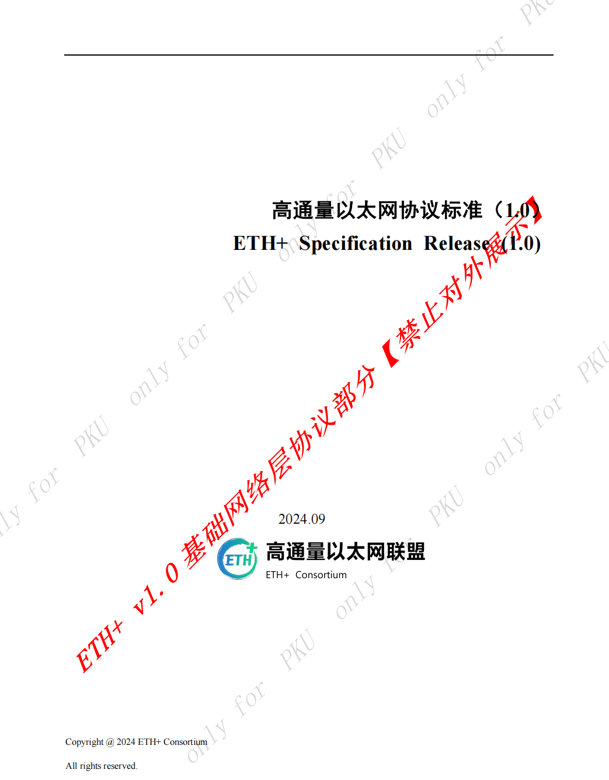
Promotion of Adoption: standardization
ETH+ Specification Release

Slide 35
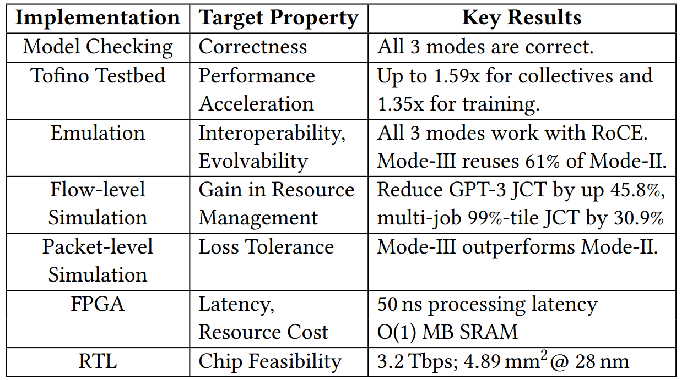
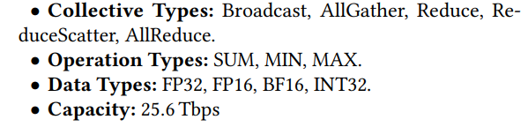
Evaluation (All parties agree)
Correctness
Performance Acceleration
Interoperability
Evolvability
Resource Manageability
Loss Tolerance
Chip Feasibility
from a chip vendor

Slide 36
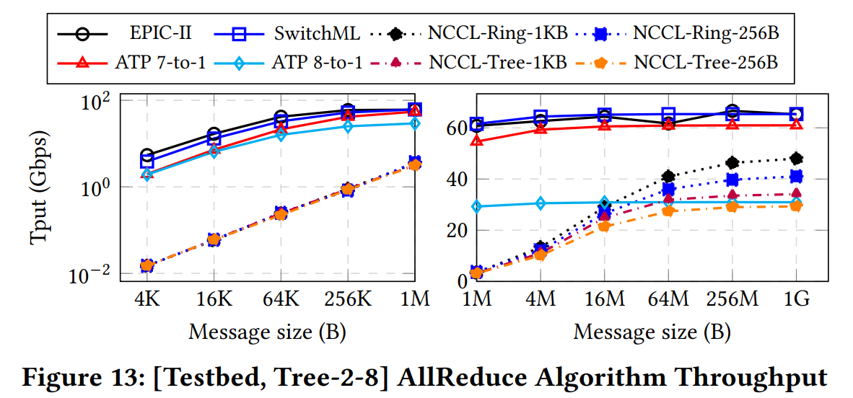
Collective Communication
INC solutions outperform non-INC solutions.
  EPIC/SwitchML/ATP > NCCL
EPIC saturates bandwidth with less CPU than SwitchML/ATP
  EPIC is hardware-offload in transmission (RoCE).

Slide 37
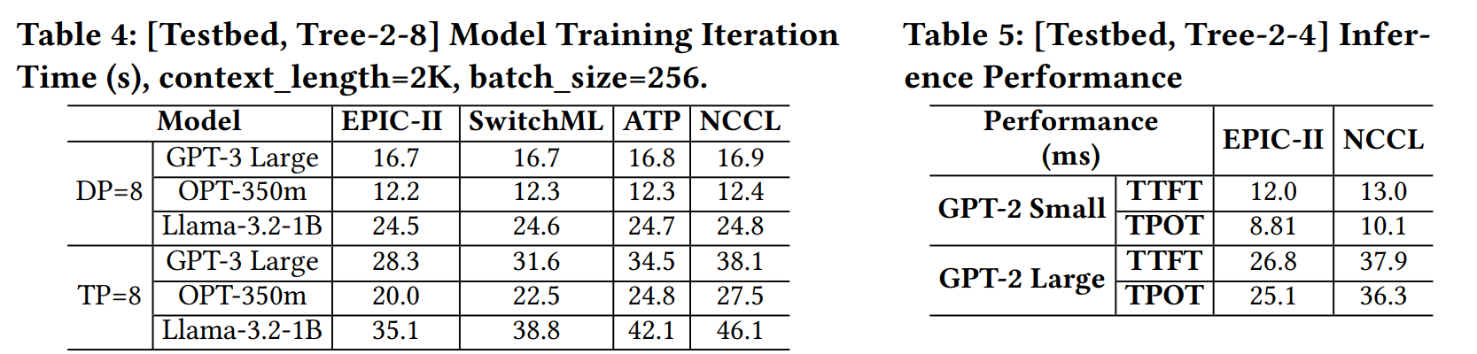
Application Performance
INC accelerates communication, so it also accelerates end-to-end performance.

Slide 38
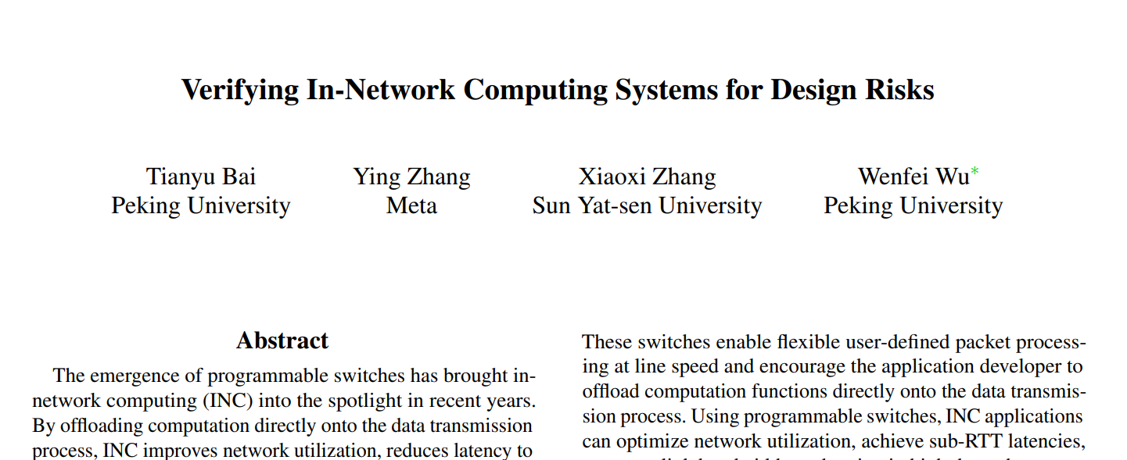
A Model Checker for INC Protocols
Provide a language to describe
  Topology
  Node behaviors
Compile to TLA+
Run to find violations
We have not apply complex optimization yet, but simple settings find several design errors from 9 INC systems.
  E.g., in a network cache, out-of-order packets can easily cause read/write hazards.
Bai et al., Verifying In-Network Computing Systems for Design Risks, ICNP 2026 (PKU, etc.)

Slide 39
Contents
Background
Enforce In-network Collective Communication on Ethernet
A New INC Case for Context Parallelism
Conclusion

Slide 40
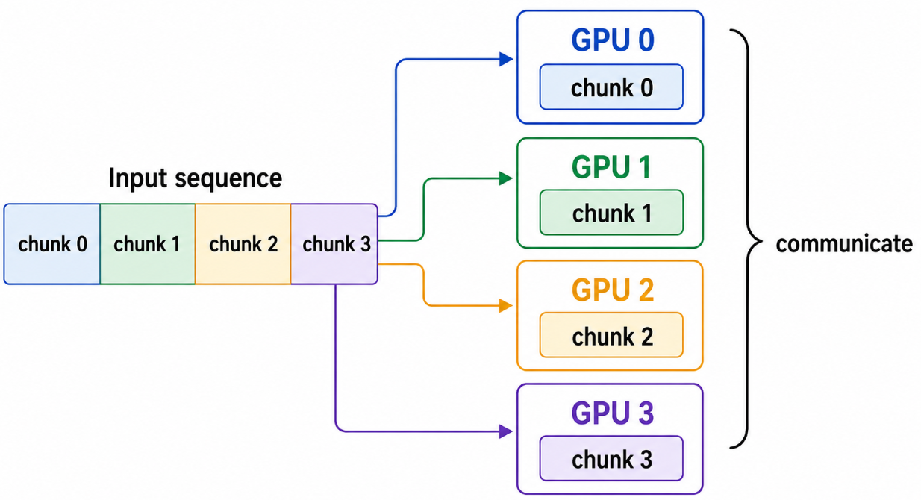
Background
Long-Context Applications：
  RAG
  Long-document understanding
  Multi-turn dialogue memory
Long-context increases:
  KV cache memory
  Attention computation
  Inter-GPU communication
CP：Split the sequence across GPUs, sharing KV cache via communication
Wan et al., Turbo: Efficiently Serving Long-Context Large Language Models with In-Network Aggregation,
SIGCOMM 2026 (SEU, PKU, Tencent, etc.)

Slide 41
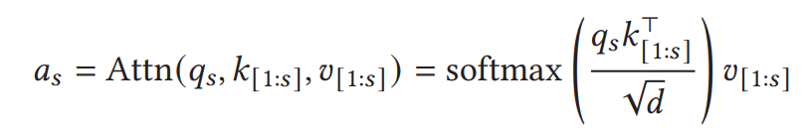
Algorithm
The current iteration has tokens 1, …s, transformed to KV cache
  k₁, …, k_{s} and v₁, …, v_{s}
  Token n’s query q_{s}
Compute attention
Generate the next token s+1

Slide 42
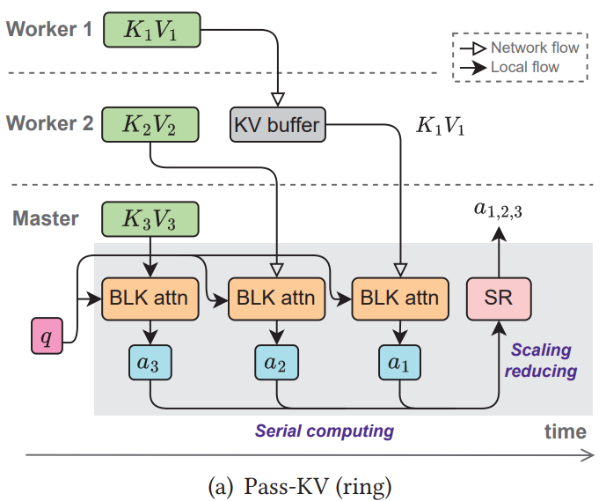
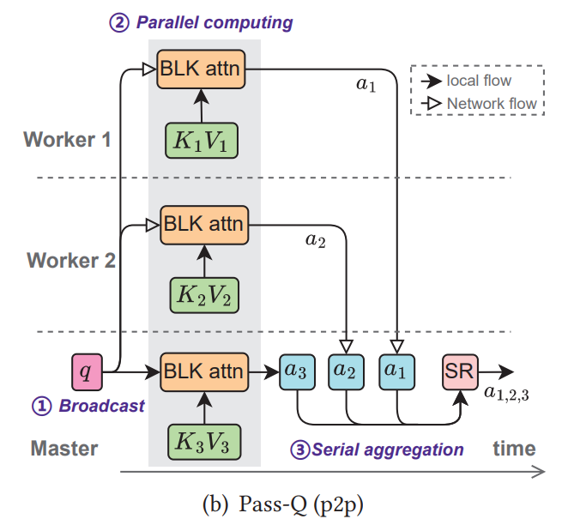
Existing Solutions & Their Limitations in Decoding
Pass-KV
  Ring： KV blocks are circulated among workers and sent to the master
  Limitation:
    High communication volume and network demand
    Decode latency increases with the number of workers
Pass-Q
  P2p：The master broadcasts queries and aggregates partial attention results
  Limitation:
    Reduces link traffic, but creates incast and reduce bottlenecks

Slide 43
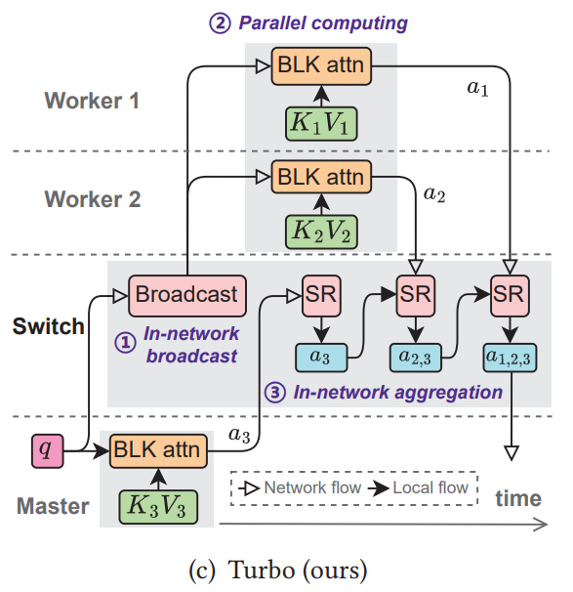
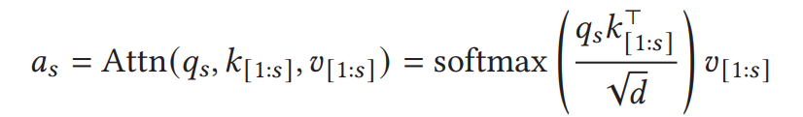
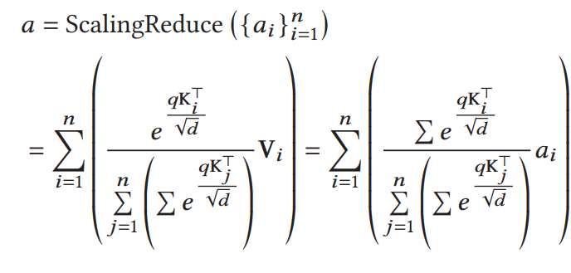
INC Solution (Turbo)
Broadcast q by the switch
Reduce “partial attention” a_{i}
by the switch

Slide 44
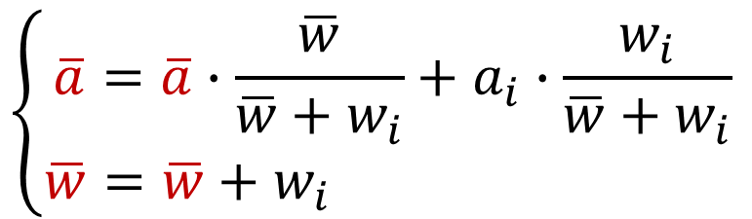

The Attention Computation
Broadcast q by the switch
  Each worker generates partial attention a_{i} and weight w_{i}
Reduce “partial attention” a_{i} by the switch
On switch, a_{i} arrives consecutively, so we incrementally compute a
$$a=\sum_{i}{\frac{w_{i}}{\sum_{j}{w_{j}}}a_{i}}$$
$$\left\{\begin{aligned}\overline{a}=\overline{a}∙\frac{\overline{w}}{\overline{w}+w_{i}}+a_{i}∙\frac{w_{i}}{\overline{w}+w_{i}} \\ \overline{w}=\overline{w}+w_{i} \end{aligned}\right.$$

Slide 45
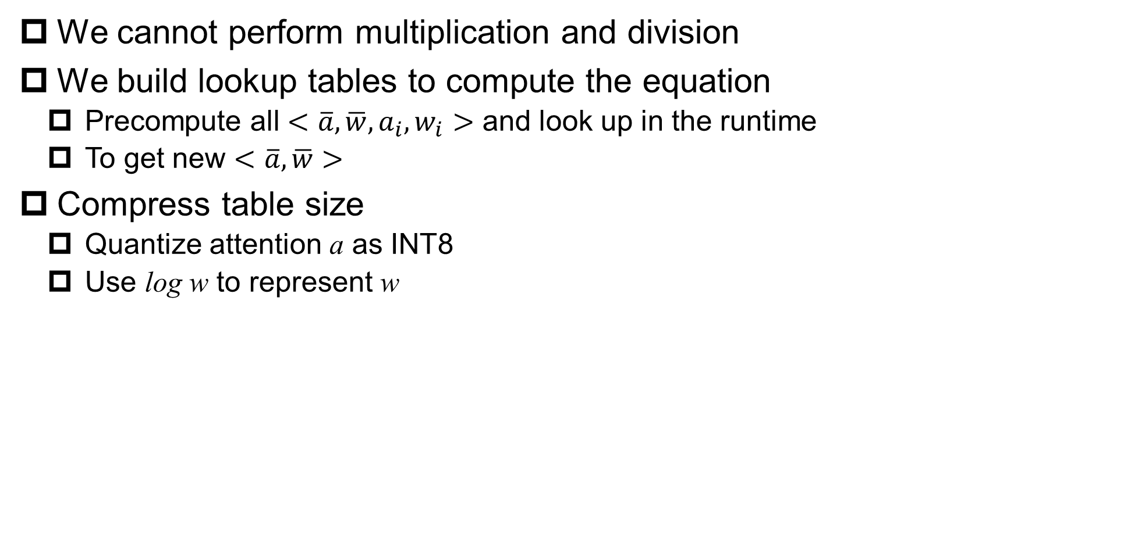
Challenge 1: Switch Programmability Limitation
We cannot perform multiplication and division
We build lookup tables to compute the equation
  Precompute all $<\overline{a}, \overline{w}, a_{i}, w_{i}>$ and look up in the runtime
  To get new $<\overline{a},\overline{w}>$
Compress table size
  Quantize attention a as INT8
  Use log w to represent w

Slide 46
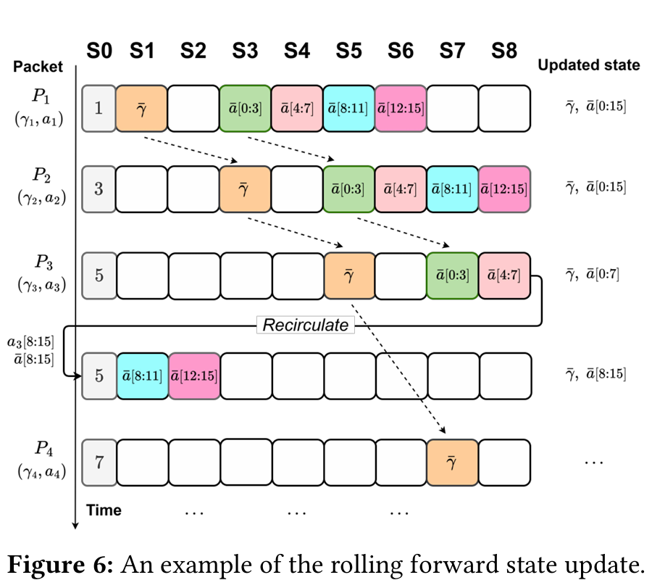
Challenge 2: Switch Memory Access Limitation
RMT pipeline constraints
  Full update logic does not fit in one stage
  Cross-stage state read/write is not allowed
Rolling-forward state update
  Split updates across stages
  Shift consecutive packets by two stages
  Read the previous state at the correct stage

Slide 47
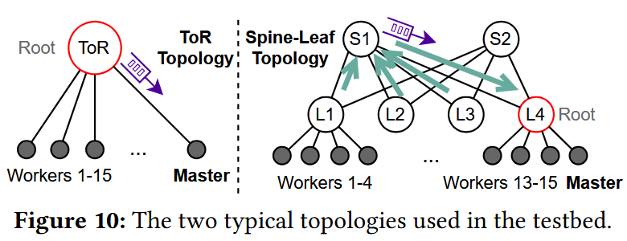
Evaluation
Testbed
  4 nodes × 2 RTX 3090 GPUs
  100 Gbps NIC
  Tofino2 programmable switch
  LLAMA-2 7B + ShareGPT
Large-scale Evaluation
  16 nodes, 200 Gbps RoCEv2
  ToR and Spine-Leaf topologies
  LLAMA-2 7B and GPT-3 175B
  up to 32 concurrent tasks

Slide 48
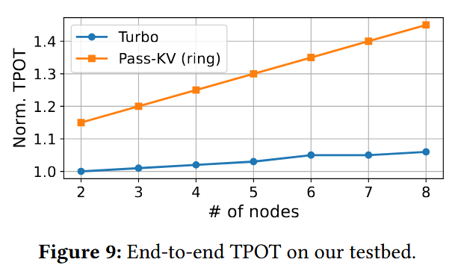

Testbed Results
Turbo scales better as the number of nodes increases
TPOT：Time Per Output Token
Up to 37%
lower decoding latency
at 8 nodes vs. Pass-KV ring

Slide 49
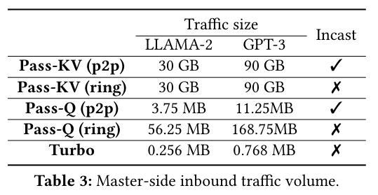
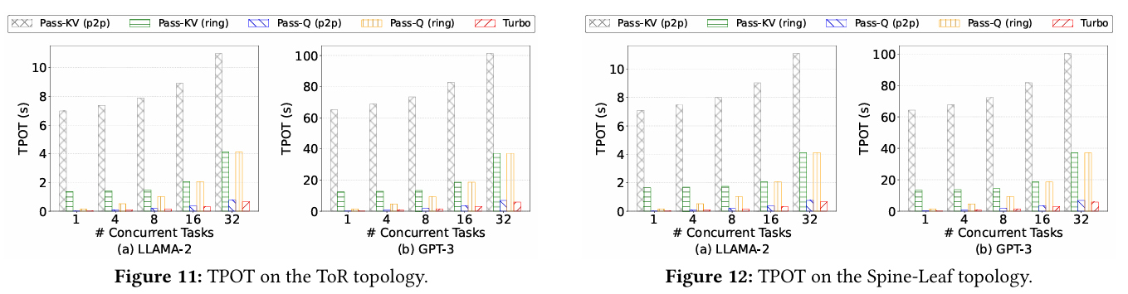
Large-scale Results
Turbo reduces master traffic while maintaining lower TPOT

Slide 50
Contents
Background
Enforce In-network Collective Communication on Ethernet
A New INC Case for Context Parallelism
Conclusion

Slide 51
Research Roadmap
Accelerate more applications
Tools for Develop-ment
Ensure correct design
Runtime Mgmt
Use resources efficiently
Machine Learning
Data
Analytics
Storage
Communication Layer
Make INC easy for developer to use
Network Devices
Raise performance ceiling
Tech stack

Slide 52
Conclusion
Years of effort shows that INC is promising to accelerate distributed systems.
EPIC enables the fragmented Ethernet ecosystem to construct cross-layer system.
  INC AllReduce algorithm is well-studied.
  Apply “unified abstraction, polymorphic realization” to bridge the fragmented ecosystem
Turbo shows another use case of INC: Context Parallelism
  It builds a new ScalingReduce primitive
  It overcomes limitations of programmable switches.

Slide 53
Future Work
Short-term goals
  For existing INC use cases, deploy them and build better management policy.
  Discover more use cases
  Build better switch microarchitectures (isolate INC and packet forwarding)
Long-term goals: Performant infrastructure to enable scientific findings
  Approach: make network the accelerator for distributed applications.
    Like that GPU is the accelerator of servers.
  What is the function (computation) to offload?
    It seems to be stream processing (data units traversing the processor)
  What is the switch hardware architecture to support the computation?
    Pipeline architecture seems reasonable (customize the ISA).
  How to develop the functions to the architecture?
    Thinking about this, extended-P4? Functional Programming?

Slide 54


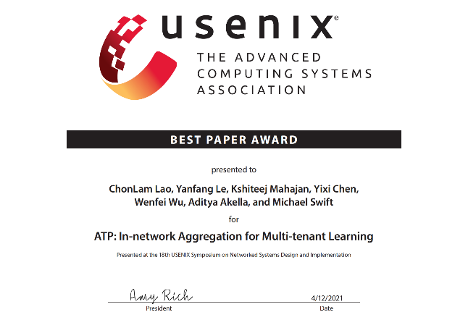

Q&A
Wenfei Wu, Assistant Professor
Focus on distributed systems and computer networking
INC workgroup leader of Eth+ Consortium
Research about INC
  INC acceleration system, to promote system execution efficiency.
  INC management, to promote cluster resource efficiency.
  INC environment adaptation, to enable agile deployment.
NSDI’21
Best Paper
ASPLOS’23
Distinguished Paper
CCPC’24
Best Academic Paper

